Slide 1
Topics Breakdown
Part II
Chemical Bonding Part I (Chapter 09) (Midterm)
Chemical Bonding Part II (Chapter 10) (Midterm)
&
Gases (Chapter 5) (Q-3)

Slide 2
Chapter 9
Chemical Bonding I

Slide 3
Chemical Bonds
There are two broad types of chemical bonding:
Ionic bond
Covalent bond

Slide 4
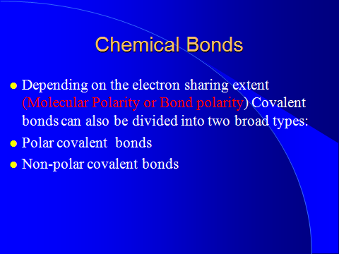

Slide 5
A Bond
Ionic Polar Nonpolar
Covalent Covalent
<<<<<<<<<<<<<<<<<<<<<<<<<<<<<<
e⁻ unequal equal
transfer sharing sharing

Slide 6
Ionic Bonds

Slide 7
Ionic Compounds
Electrons are transferred forming cations and anions
The resulting ions attract each other through electrostatic forces

Slide 8


Slide 9
Formation of Ionic Bond

Slide 10
Formation of Sodium Chloride
2 Na(s) + Cl₂(g)

Slide 11
Formation of Sodium Chloride
2 Na(s) + Cl₂(g)
1s²2s²2p⁶3s¹

Slide 12
Formation of Sodium Chloride
2 Na(s) + Cl₂(g)
1s²2s²2p⁶3s¹
1 extra e⁻

Slide 13
Formation of Sodium Chloride
2 Na(s) + Cl₂(g)
1s²2s²2p⁶3s¹ 1s²2s²2p⁶3s²3p⁵

Slide 14
Formation of Sodium Chloride
2 Na(s) + Cl₂(g)
1s²2s²2p⁶3s¹ 1s²2s²2p⁶3s²3p⁵
1 e⁻ short on each atom

Slide 15
Formation of Sodium Chloride
2 Na(s) + Cl₂(g)
1s²2s²2p⁶3s¹ 1s²2s²2p⁶3s²3p⁵
Things would be hunky-dory if each sodium atom would give its extra electron to chlorine

Slide 16
Formation of Sodium Chloride
2 Na(s) + Cl₂(g)
1s²2s²2p⁶3s¹ 1s²2s²2p⁶3s²3p⁵
2 Na⁺ + 2 Cl⁻

Slide 17
Formation of Sodium Chloride
2 Na(s) + Cl₂(g)
1s²2s²2p⁶3s¹ 1s²2s²2p⁶3s²3p⁵
2 Na⁺ + 2 Cl⁻
1s²2s²2p⁶
a “neon” octet
[Ne]

Slide 18
Formation of Sodium Chloride
2 Na(s) + Cl₂(g)
1s²2s²2p⁶3s¹ 1s²2s²2p⁶3s²3p⁵
.
2 Na⁺ + 2 Cl⁻
1s²2s²2p⁶ 1s²2s²2p⁶3s²3p⁶
a “neon” octet an “argon” octet
[Ne] [Ar]

Slide 19
The Duet Rule
Stable species are found with noble gas electron configurations
Small elements tend towards a helium outer shell, a “duet” rule

Slide 20
Examples of the Duet Rule
He 1s² or [He] helium atom
Li⁺ 1s² or [He] lithium cation
Be²⁺ 1s² or [He] beryllium cation
H⁻ 1s² or [He] hydride anion

Slide 21
Formulas of Ionic Compounds
Positive and negative charges must balance
Only one combination carries the correct simplest ratio of whole numbers

Slide 22
Example Formulas
NaCl

Slide 23
Example Formulas
NaCl Na⁺ Cl⁻

Slide 24
Example Formulas
NaCl Na⁺ Cl⁻ (+1) + (-1) = 0

Slide 25
Example Formulas
NaCl Na⁺ Cl⁻ (+1) + (-1) = 0
CaO

Slide 26
Example Formulas
NaCl Na⁺ Cl⁻ (+1) + (-1) = 0
CaO Ca²⁺ O²⁻

Slide 27
Example Formulas
NaCl Na⁺ Cl⁻ (+1) + (-1) = 0
CaO Ca²⁺ O²⁻ (+2) + (-2) = 0

Slide 28
Example Formulas
NaCl Na⁺ Cl⁻ (+1) + (-1) = 0
CaO Ca²⁺ O²⁻ (+2) + (-2) = 0
K₂O

Slide 29
Example Formulas
NaCl Na⁺ Cl⁻ (+1) + (-1) = 0
CaO Ca²⁺ O²⁻ (+2) + (-2) = 0
K₂O K⁺ O²⁻

Slide 30
Example Formulas
NaCl Na⁺ Cl⁻ (+1) + (-1) = 0
CaO Ca²⁺ O²⁻ (+2) + (-2) = 0
K₂O K⁺ O²⁻ 2(+1) + (-2) = 0

Slide 31
Example Formulas
NaCl Na⁺ Cl⁻ (+1) + (-1) = 0
CaO Ca²⁺ O²⁻ (+2) + (-2) = 0
K₂O K⁺ O²⁻ 2(+1) + (-2) = 0
Mg₃N₂

Slide 32
Example Formulas
NaCl Na⁺ Cl⁻ (+1) + (-1) = 0
CaO Ca²⁺ O²⁻ (+2) + (-2) = 0
K₂O K⁺ O²⁻ 2(+1) + (-2) = 0
Mg₃N₂ Mg²⁺ N³⁻

Slide 33
Example Formulas
NaCl Na⁺ Cl⁻ (+1) + (-1) = 0
CaO Ca²⁺ O²⁻ (+2) + (-2) = 0
K₂O K⁺ O²⁻ 2(+1) + (-2) = 0
Mg₃N₂ Mg²⁺ N³⁻ 3(+2) + 2(-3) = 0

Slide 34
Ionic Crystal Structures
Ions are packed into a 3-dimensional array called a crystal lattice
Ionic bonds radiate out in all directions between ions of opposite charge
Figure in the next slide shows the sodium chloride crystal form
Entire structure is an ionic network solid

Slide 35
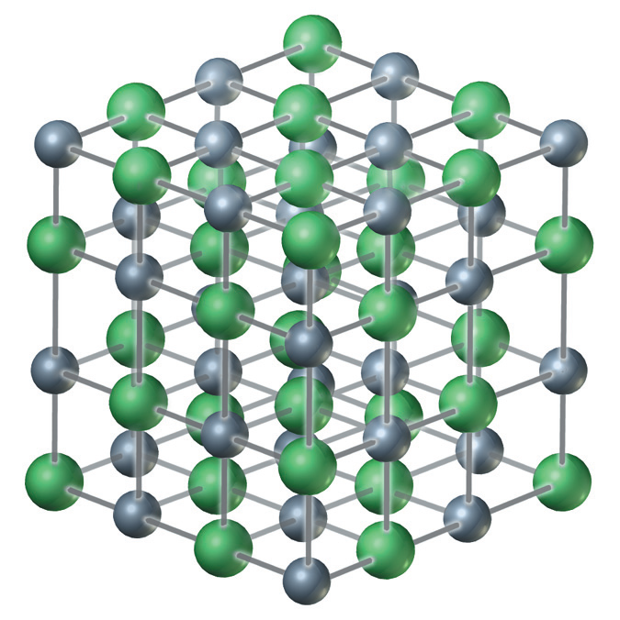
Na⁺
Cl⁻

Slide 36
No such thing as an ionic molecule
Formulas used for ionic compounds are purely the atom ratios
There are no subunits arranged in groupings that follow the formula
Don’t talk about molecules with ionics if you want to be precise

Slide 37
Examples of Ionic Lattices
Halite
NaCl sodium chloride
Wurtzite
ZnS zinc sulfide
Calcite
CaCO₃ calcium carbonate
Muscovite (white mica)
. KAl₃Si₃O₁₀(OH)₂

Slide 38
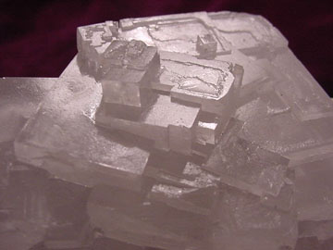
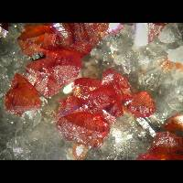
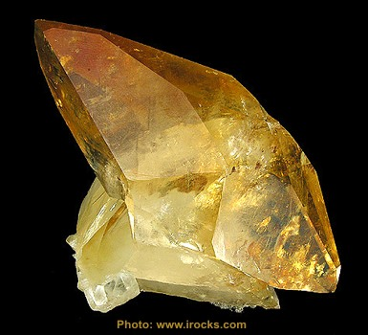
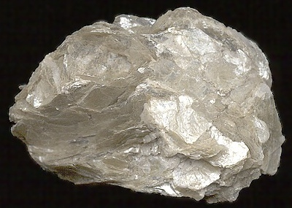
Halite, NaCl
Wurtzite, ZnS
Calcite, CaCO₃
Muscovite, KAl₃Si₃O₁₀(OH)₂

Slide 39
The “Crossover” Method
Write down the component cation and anion with charges
Exchange the charges as subscripts
Simplify if needed

Slide 40
Example 1: Potassium Sulfide

Slide 41
Example 1: Potassium Sulfide
K⁺

Slide 42
Example 1: Potassium Sulfide
K⁺
S²⁻

Slide 43
Example 1: Potassium Sulfide
K⁺
S²⁻
K₂S
Cation 1st

Slide 44
Example 1: Potassium Sulfide
K⁺
S²⁻
K₂S
Anion 2nd

Slide 45
Example 1: Potassium Sulfide
K⁺
S²⁻
K₂S
No subscript if only 1

Slide 46
Example 1: Potassium Sulfide
K⁺
S²⁻
K₂S

Slide 47
Example 1: Potassium Sulfide
K⁺
S²⁻
K₂S

Slide 48
Example 2: Potassium Fluoride

Slide 49
Example 2: Potassium Fluoride
K⁺

Slide 50
Example 2: Potassium Fluoride
K⁺
F⁻

Slide 51
Example 2: Potassium Fluoride
K⁺
F⁻
KF
No subscript if only 1

Slide 52
Example 2: Potassium Fluoride
K⁺
F⁻
KF
No subscript if only 1

Slide 53
Example 2: Potassium Fluoride
K⁺
F⁻
KF

Slide 54
Example 2: Potassium Fluoride
K⁺
F⁻
K⁺F⁻
NOT!

Slide 55
Example 2: Potassium Fluoride
K⁺
F⁻
KF

Slide 56
Example 3: Calcium Carbonate

Slide 57
Example 3: Calcium Carbonate
Ca²⁺

Slide 58
Example 3: Calcium Carbonate
Ca²⁺
CO₃²⁻

Slide 59
Example 3: Calcium Carbonate
Ca²⁺
CO₃²⁻
Ca₂(CO₃)₂
Polyatomic ions need parentheses when subscripts are added

Slide 60
Example 3: Calcium Carbonate
Ca²⁺
CO₃²⁻
Ca₂(CO₃)₂

Slide 61
Example 3: Calcium Carbonate
Ca²⁺
CO₃²⁻
Ca₂(CO₃)₂

Slide 62
Example 3: Calcium Carbonate
Ca²⁺
CO₃²⁻
Now simplify, both subscripts are 2
Ca₂(CO₃)₂

Slide 63
Example 3: Calcium Carbonate
Ca²⁺
CO₃²⁻
Ca(CO₃)

Slide 64
Example 3: Calcium Carbonate
Ca²⁺
CO₃²⁻
Ca(CO₃)
Parentheses no longer needed

Slide 65
Example 3: Calcium Carbonate
Ca²⁺
CO₃²⁻
CaCO₃

Slide 66
What is the formula for sodium oxide?
NaO
Na₂O
NaO₂
Na₂O₂

Slide 67
What is the formula for sodium oxide?
NaO
Na₂O
NaO₂
Na₂O₂
2(+1) + (-2) = 0

Slide 68
Example 4: Magnesium Phosphate

Slide 69
Example 4: Magnesium Phosphate
Mg²⁺

Slide 70
Example 4: Magnesium Phosphate
Mg²⁺
PO₄³⁻

Slide 71
Example 4: Magnesium Phosphate
Mg²⁺
PO₄³⁻
Use parentheses with polyatomic ions needing subscripts
Mg₃(PO₄)₂

Slide 72
Example 4: Magnesium Phosphate
Mg²⁺
PO₄³⁻
Mg₃(PO₄)₂

Slide 73
Example 4: Magnesium Phosphate
Mg²⁺
PO₄³⁻
Mg₃(PO₄)₂

Slide 74
Example 5: Lead(IV) Oxide

Slide 75
Example 5: Lead(IV) Oxide
Pb⁴⁺

Slide 76
Example 5: Lead(IV) Oxide
Pb⁴⁺
O²⁻

Slide 77
Example 5: Lead(IV) Oxide
Pb⁴⁺
O²⁻
Pb₂O₄

Slide 78
Example 5: Lead(IV) Oxide
Pb⁴⁺
O²⁻
Pb₂O₄

Slide 79
Example 5: Lead(IV) Oxide
Pb⁴⁺
O²⁻
Pb₂O₄

Slide 80
Example 5: Lead(IV) Oxide
Pb⁴⁺
O²⁻
Not simplest whole-number ratio
Pb₂O₄

Slide 81
Example 5: Lead(IV) Oxide
Pb⁴⁺
O²⁻
PbO₂

Slide 82
Example 6: Ammonium Carbonate

Slide 83
Example 6: Ammonium Carbonate
NH₄⁺

Slide 84
Example 6: Ammonium Carbonate
NH₄⁺
CO₃²⁻

Slide 85
Example 6: Ammonium Carbonate
NH₄⁺
CO₃²⁻
NH₄CO₃
No subscript if 1

Slide 86
Example 6: Ammonium Carbonate
NH₄⁺
CO₃²⁻
(NH₄)₂CO₃
Use parentheses for subscripted polyatomic ions

Slide 87
Example 6: Ammonium Carbonate
NH₄⁺
CO₃²⁻
(NH₄)₂CO₃

Slide 88
What is the formula for barium hydroxide?
BaOH₂
BaOH
Ba₂OH
Ba(OH)₂

Slide 89
What is the formula for barium hydroxide?
BaOH₂
BaOH
Ba₂OH
Ba(OH)₂
(+2) + 2(-1) = 0

Slide 90
What is the formula for gold(III) (Au³⁺) sulfate (SO₄²⁻)?
AuSO₄
Au(SO₄)
Au₃(SO₄)₂
Au₂(SO₄)₃
Au(SO₂)₃

Slide 91
What is the formula for gold(III) (Au³⁺) sulfate (SO₄²⁻)?
AuSO₄
Au(SO₄)
Au₃(SO₄)₂
Au₂(SO₄)₃
Au(SO₂)₃
2(+3) + 3(-2) = 0

Slide 92
Naming Ionic Compounds
Naming ionic compounds is simply the reverse of writing their formulas
Simply list the names of the component ions (subscripts can give you valuable clues!)
Always list the cation first
Leave a space between the cation and anion names

Slide 93
Ionic Compound Names

Slide 94
Ionic Compound Names
Cation name

Slide 95
Ionic Compound Names
Cation name
(space)

Slide 96
Ionic Compound Names
Cation name
(space)
Anion name

Slide 97
Ionic Compound Names
Cation name
(space)
Anion name
What is the name of ZnS?

Slide 98
Ionic Compound Names
Cation name
(space)
Anion name
What is the name of ZnS?
Name as ionic because first element in formula is a metal

Slide 99
Ionic Compound Names
Cation name
(space)
Anion name
zinc
What is the name of ZnS?

Slide 100
Ionic Compound Names
Cation name
(space)
Anion name
zinc
What is the name of ZnS?

Slide 101
Ionic Compound Names
Cation name
(space)
Anion name
zinc sulfide
What is the name of ZnS?

Slide 102
Ionic Compound Names
Cation name
(space)
Anion name
zinc sulfide
What is the name of ZnS?

Slide 103
Ionic Compound Names
Cation name
(space)
Anion name
What is the name of MgCl₂?

Slide 104
Ionic Compound Names
Cation name
(space)
Anion name
What is the name of MgCl₂?
Name as ionic because first element in formula is a metal

Slide 105
Ionic Compound Names
Cation name
(space)
Anion name
magnesium
What is the name of MgCl₂?

Slide 106
Ionic Compound Names
Cation name
(space)
Anion name
magnesium
What is the name of MgCl₂?

Slide 107
Ionic Compound Names
Cation name
(space)
Anion name
magnesium chloride
What is the name of MgCl₂?

Slide 108
Ionic Compound Names
Cation name
(space)
Anion name
magnesium chloride
What is the name of MgCl₂?

Slide 109
Ionic Compound Names
Cation name
(space)
Anion name
NOT
magnesium dichloride
What is the name of MgCl₂?

Slide 110
Ionic Compound Names
Cation name
(space)
Anion name
magnesium chloride
What is the name of MgCl₂?

Slide 111
Review exercise: Aluminum nitrate

Slide 112
Review exercise: Aluminum nitrate
Al³⁺

Slide 113
Review exercise: Aluminum nitrate
Al³⁺
NO₃⁻

Slide 114
Review exercise: Aluminum nitrate
Al³⁺
NO₃⁻
Al(NO₃)₃

Slide 115
Ionic Compound Names
Cation name
(space)
Anion name
potassium phosphate
What is the name of K₃PO₄?

Slide 116
What is the name of Cu₂SO₃?
Copper sulfite
Copper sulfate
Copper(I) sulfite
Copper(I) sulfate
Copper(II) sulfite
Copper(II) sulfate
Dicopper sulfite
Dicopper sulfate

Slide 117
What is the name of Cu₂SO₃?
Copper sulfite
Copper sulfate
Copper(I) sulfite
Copper(I) sulfate
Copper(II) sulfite
Copper(II) sulfate
Dicopper sulfite
Dicopper sulfate
Or cuprous sulfite

Slide 118
What is the name of Cu₂SO₃?
Copper sulfite
Copper sulfate
Copper(I) sulfite
Copper(I) sulfate
Copper(II) sulfite
Copper(II) sulfate
Dicopper sulfite
Dicopper sulfate
Or cuprous sulfite
Thinking of the formula this way --Cu₂(SO₃)₁ -- may help you to uncross the subscripts and realize that it’s copper(I).

Slide 119
What is the name of Al(HSO₃)₃?
Aluminum(III) hydrogen sulfite
Aluminum(III) hydrogen sulfate
Aluminum bisulfite
Aluminum bisulfate
Aluminum hydrogen sulfite
Aluminum hydrogen sulfate

Slide 120
What is the name of Al(HSO₃)₃?
Aluminum(III) hydrogen sulfite
Aluminum(III) hydrogen sulfate
Aluminum bisulfite
Aluminum bisulfate
Aluminum hydrogen sulfite
Aluminum hydrogen sulfate
Only include Roman numerals for transition metals with more than one ion form

Slide 121
A Bond
Ionic Polar Nonpolar
Covalent Covalent
<<<<<<<<<<<<<<<<<<<<<<<<<<<<<<
e⁻ unequal equal
transfer sharing sharing

Slide 122
A Covalent bond

Slide 123
Covalent Bonds
Formed by sharing a pair of negatively charged electrons between two positively charged nuclei
Like the rope in a tug-of-war
The two teams (the nuclei) are “bonded” because they are tugging on opposite ends of the same rope (the electrons)

Slide 124
A Covalent bond
Ionic Compounds
Network solids
High melting point
Rocks, concrete, dry wall, ...
Covalent Compounds
Network or molecular solids
Gas, liquid or solid
Water, air, wood, muscle, plastic, sugar, ...

Slide 125
Three Places to Find Covalent Bonds
1 - Molecular substances
Organized into small units
Water H₂O
Carbon dioxide CO₂

Slide 126
Three Places to Find Covalent Bonds
2 - Covalent networks
Infinite lattice, sheet or chain of covalently bound atoms
Diamond C(diamond)
Quartz SiO₂
Wood -(CH₂O)_{n}-
Plastic -(CH₂)_{n}-

Slide 127
Three Places to Find Covalent Bonds
3 - Polyatomic ions
Small units that carry a net charge
Ammonium ion NH₄⁺
Carbonate ion CO₃²⁻
Atoms within each ion are covalently bound

Slide 128
H₂, the Hydrogen Molecule
Each hydrogen has one valence electron
Each hydrogen needs only one more e⁻ to achieve a stable noble gas configuration
H 1s¹

Slide 129
H₂, the Hydrogen Molecule
Each hydrogen has one valence electron
Each hydrogen needs only one more e⁻ to achieve a stable noble gas configuration
H 1s¹ He 1s²

Slide 130
H₂, the Hydrogen Molecule
Each hydrogen has one valence electron
Each hydrogen needs only one more e⁻ to achieve a stable noble gas configuration
H 1s¹ He 1s²
If two hydrogens pair up and share their electrons with each other, each has a helium configuration at least part of the time

Slide 131
H₂, the Hydrogen Molecule

Slide 132
H₂, the Hydrogen Molecule
A hydrogen atom
e⁻
P⁺

Slide 133
H₂, the Hydrogen Molecule
A hydrogen atom
Another hydrogen atom
e⁻
P⁺
P⁺
e⁻

Slide 134
H₂, the Hydrogen Molecule
As the two approach...
e⁻
P⁺
P⁺
e⁻

Slide 135
H₂, the Hydrogen Molecule
…new attractions are felt
e⁻
P⁺
P⁺
e⁻

Slide 136
H₂, the Hydrogen Molecule
A covalent bond is formed!
e⁻
P⁺
P⁺
e⁻

Slide 137
H₂, the Hydrogen Molecule
The region in which the electrons are found is a sigma (σ) molecular orbital
e⁻
P⁺
P⁺
σ
e⁻

Slide 138
Bond Notations
H:H
The pair of dots represent the two e⁻’s
H - H
The dash represents the two e⁻’s
H₂
The bond is assumed

Slide 139
Bond Notations
H:H
The pair of dots represent the two e⁻’s
H - H
The dash represents the two e⁻’s
H₂
The bond is assumed
I like to mark σ bonds like this
σ

Slide 140
H₂, the Hydrogen Molecule
Each hydrogen has a noble gas configuration through sharing
e⁻
P⁺
P⁺
σ
e⁻

Slide 141
H₂, the Hydrogen Molecule
Each hydrogen has a noble gas configuration through sharing
Each hydrogen has a noble gas configuration through sharing
e⁻
P⁺
P⁺
e⁻

Slide 142
H₂, the Hydrogen Molecule
Each hydrogen has a noble gas configuration through sharing
Each hydrogen has a noble gas configuration through sharing
e⁻
P⁺
P⁺
e⁻

Slide 143
H₂, the Hydrogen Molecule
MasterCard
Sigma National Bank

Slide 144
H₂, the Hydrogen Molecule
Each hydrogen has a noble gas configuration through sharing
Each hydrogen has a noble gas configuration through sharing
e⁻
P⁺
P⁺
e⁻

Slide 145
Diatomic Halogen Molecules
The halogens all form diatomic molecules containing a sigma bond
F₂ Cl₂ Br₂ I₂
By sharing one e⁻ apiece they each achieve a noble gas configuration
F - F

Slide 146
Diatomic Halogen Molecules
The halogens all form diatomic molecules containing a sigma bond
F₂ Cl₂ Br₂ I₂
By sharing one e⁻ apiece they each achieve a noble gas configuration
F - F
σ

Slide 147
Lewis Structures

Slide 148
Lewis Structures
Sharing of electron pairs can be diagrammed in detail with Lewis Electron Dot Structures
Each atom begins with its valence electrons
A dash represents two shared electrons in a bond
Unbonded electrons are kept in lone pairs

Slide 149
Three types of covalent bonds
A Single Bond – only a pair of electrons are shared between two atoms
A Double Bond – two pairs of electrons are shared between two atoms
A Triple Bond – three pairs of electrons are shared between two atoms
Again un-bonded electrons are kept in lone pairs

Slide 150
The Single Bond

Slide 151
Fluorine
7A
⁹ F

Slide 152
Fluorine
Number of valence e⁻’s = group number
7A
⁹ F

Slide 153
The F₂ Molecule
Fluorine must share one electron to achieve a noble gas configuration
F atom: 1s²2s²2p⁵

Slide 154
The F₂ Molecule
One e- short
Fluorine must share one electron to achieve a noble gas configuration
F atom: 1s²2s²2p⁵

Slide 155
The F₂ Molecule
7 valence e-’s
Fluorine must share one electron to achieve a noble gas configuration
F atom: 1s²2s²2p⁵

Slide 156
The F₂ Molecule

Slide 157
The F₂ Molecule
F F

Slide 158
The F₂ Molecule
F F
Each fluorine has 7 valence electrons

Slide 159
The F₂ Molecule
F F
Each fluorine has 7 valence electrons

Slide 160
The F₂ Molecule
The dots are paired to show paired spins in orbitals
F F
Each fluorine has 7 valence electrons

Slide 161
The F₂ Molecule
F F
Each fluorine has 7 valence electrons

Slide 162
The F₂ Molecule
F F
Each fluorine has 7 valence electrons

Slide 163
The F₂ Molecule
F F
Each fluorine has 7 valence electrons

Slide 164
The F₂ Molecule
F F
Each fluorine has 7 valence electrons

Slide 165
The F₂ Molecule
F F
The 2nd fluorine now gets 7 valence electrons
Each fluorine has 7 valence electrons

Slide 166
The F₂ Molecule
F F

Slide 167
The F₂ Molecule
F F

Slide 168
The F₂ Molecule
F F

Slide 169
The F₂ Molecule
F F

Slide 170


The F₂ Molecule
F F
Bonding pair of electrons

Slide 171





The F₂ Molecule
F F
Lone Pairs
Lone Pairs

Slide 172




The F₂ Molecule
F F
An octet achieved by left fluorine

Slide 173


The F₂ Molecule
F F
An octet achieved by left fluorine
An octet achieved by right fluorine

Slide 174

The F₂ Molecule
F F
An “official” Lewis structure

Slide 175
The F₂ Molecule
σ
F F
An “official” Lewis structure
Remember it’s a σ-bond

Slide 176
Double and Triple Bonds
The remaining two diatomic elements in the second row are more complicated
O₂ has a double bond
N₂ has a triple bond

Slide 177
The Double Bond

Slide 178
Oxygen
6A
⁸ O

Slide 179
Oxygen
Number of valence e⁻’s = group number
6A
⁸ O

Slide 180
The O₂ Molecule
Oxygen must share two electrons to achieve a noble gas configuration
O atom: 1s²2s²2p⁴

Slide 181
The O₂ Molecule
Two e-’s short
Oxygen must share two electrons to achieve a noble gas configuration
O atom: 1s²2s²2p⁴

Slide 182
The O₂ Molecule
6 valence e-’s
Oxygen must share two electrons to achieve a noble gas configuration
O atom: 1s²2s²2p⁴

Slide 183
The O₂ Molecule

Slide 184
The O₂ Molecule
O O

Slide 185
The O₂ Molecule
O O
Each oxygen has 6 valence electrons

Slide 186
The O₂ Molecule
O O
Each oxygen has 6 valence electrons

Slide 187
The O₂ Molecule
O O
Each oxygen has 6 valence electrons

Slide 188
The O₂ Molecule
O O
Each oxygen has 6 valence electrons

Slide 189
The O₂ Molecule
O O
Each oxygen has 6 valence electrons
Now the 2nd oyxgen gets 6 valence electrons

Slide 190
The O₂ Molecule
O O
Each oxygen has 6 valence electrons

Slide 191
The O₂ Molecule
O O
Each oxygen has 6 valence electrons

Slide 192
The O₂ Molecule
O O
Each oxygen has 6 valence electrons

Slide 193
The O₂ Molecule
O O
2 pairs of electrons are shared

Slide 194
The O₂ Molecule
O O
An octet for the left oxygen

Slide 195



The O₂ Molecule
O O
An octet for the left oxygen
An octet for the right oxygen

Slide 196
The O₂ Molecule
O O
The traditional Lewis structure for O₂

Slide 197
The Double Bond
There are 2 pairs of electrons shared
The first pair is in a σ-bond
Second pair is a new type of covalent bond -
a pi bond (π-bond)

Slide 198
The Double Bond

Slide 199
The Double Bond
O
O

Slide 200
The Double Bond
O
O
The first pair of e⁻’s are in a σ-orbital

Slide 201
The Double Bond
O
σ-orbital
O
The first pair of e⁻’s are in a σ-orbital

Slide 202
The Double Bond
O
σ-orbital
O
The second pair of e⁻’s are in a π-molecular orbital

Slide 203
The Double Bond
O
σ-orbital
O
Like a p-atomic orbital it has two lobes

Slide 204






The Double Bond
π⁺-orbital
O
σ-orbital
O
π⁻-orbital

Slide 205
The Double Bond
π⁺-orbital
O
σ-orbital
O
π⁻-orbital
One pair of shared electrons is in the σ-orbital (with opposite spins)

Slide 206
The Double Bond
π⁺-orbital
O
σ-orbital
O
π⁻-orbital
Another pair is in the π-orbital (with opposite spins)

Slide 207
The Double Bond
π⁺-orbital
O
σ-orbital
O
π⁻-orbital
Another pair is in the π-orbital (with opposite spins)

Slide 208
The Double Bond
If I slice the double bond in half...
π⁺-orbital
O
σ-orbital
O
π⁻-orbital

Slide 209
The Double Bond
…it looks like this
π⁺-orbital
σ-orbital
π⁻-orbital

Slide 210
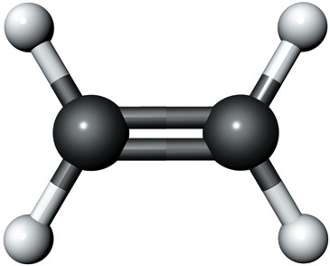


Your text’s (poor) depiction of a double bond

Slide 211
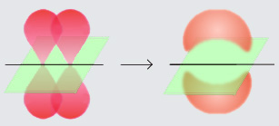



Better depictions of a double bond
Forming the two lobes of a π-orbital
http://en.wikipedia.org/wiki/Image:Pi-bond.jpg

Slide 212
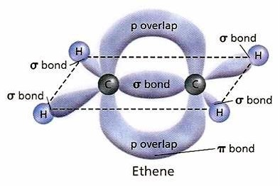




http://www.megamolecules.com/picts/MG500_diagram.jpg

Slide 213

http://tcdsbstaff.ednet.ns.ca/devillg/ib/pics/dbond.jpg

Slide 214
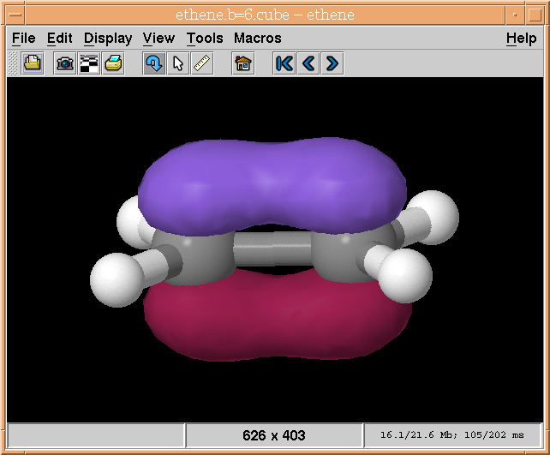
http://www.tcm.phy.cam.ac.uk/~mjr/vis/jm_iso2.png

Slide 215
The O₂ Molecule
O O
So the double bond is…

Slide 216
The O₂ Molecule
O O
σ
So the double bond is…
one σ-bond

Slide 217
The O₂ Molecule
O O
σ
π
So the double bond is…
one σ-bond
one π-bond

Slide 218
The O₂ Molecule
O O
σ
π
An official Lewis structure
one σ-bond
one π-bond
Four lone pairs

Slide 219
Double Bonding Elements

Slide 220
Double Bonding Elements
Only five elements participate in double bonds

Slide 221
Double Bonding Elements
Only five elements participate in double bonds
⁶ C

Slide 222
Double Bonding Elements
Only five elements participate in double bonds
⁶ C
⁷ N

Slide 223
Double Bonding Elements
Only five elements participate in double bonds
⁶ C
⁷ N
⁸ O

Slide 224
Double Bonding Elements
Only five elements participate in double bonds
⁶ C
⁷ N
⁸ O
¹⁵P

Slide 225
Double Bonding Elements
Only five elements participate in double bonds
⁶ C
⁷ N
⁸ O
¹⁵P
¹⁶S

Slide 226
The Triple Bond

Slide 227
Nitrogen
5A
⁷ N

Slide 228
Nitrogen
Number of valence e⁻’s = group number
5A
⁷ N

Slide 229
The N₂ Molecule
Nitrogen must share three electrons to achieve a noble gas configuration
N atom: 1s²2s²2p³

Slide 230
The N₂ Molecule
Three e-’s short
Nitrogen must share three electrons to achieve a noble gas configuration
N atom: 1s²2s²2p³

Slide 231
The N₂ Molecule
5 valence e-’s
Nitrogen must share three electrons to achieve a noble gas configuration
N atom: 1s²2s²2p³

Slide 232
The N₂ Molecule

Slide 233
The N₂ Molecule
N N

Slide 234
The N₂ Molecule
N N
Each nitrogen has 5 valence electrons

Slide 235
The N₂ Molecule
N N
Each nitrogen has 5 valence electrons

Slide 236
The N₂ Molecule
N N
Each nitrogen has 5 valence electrons

Slide 237
The N₂ Molecule
N N
Now the 2nd nitrogen gets 5 valence electrons
Each nitrogen has 5 valence electrons

Slide 238
The N₂ Molecule
N N
Each nitrogen has 5 valence electrons

Slide 239

The N₂ Molecule
N N
Each nitrogen has 5 valence electrons

Slide 240
The N₂ Molecule
N N
Three bonding pairs

Slide 241
The N₂ Molecule
N N
The left nitrogen has achieved an octet

Slide 242
The N₂ Molecule
N N
The left nitrogen has achieved an octet
The right nitrogen has achieved an octet

Slide 243
The N₂ Molecule
N N
The traditional Lewis structure for N₂

Slide 244
The Triple Bond
There are 3 pairs of electrons shared
The first pair is in a σ-bond
The second pair is in a pi-bond (π-bond)
The third pair is in a second pi-bond (π-bond)

Slide 245
The Triple Bond

Slide 246
The Triple Bond
N
N

Slide 247
The Triple Bond
N
N
The first pair of e⁻’s are in a σ-orbital

Slide 248
The Triple Bond
N
σ-orbital
N
The first pair of e⁻’s are in a σ-orbital

Slide 249
The Triple Bond
N
σ-orbital
N
The second pair of e⁻’s are in a π-molecular orbital

Slide 250
The Triple Bond
π₁⁺-orbital
N
σ-orbital
N
π₁⁻-orbital

Slide 251
The Triple Bond
π₁⁺-orbital
N
σ-orbital
N
π₁⁻-orbital
The third pair are in a second π-orbital

Slide 252





The Triple Bond
π₁⁺-orbital
σ-orbital
π₂⁺-orbital
N
σ-orbital
π₂⁻-orbital
N
π₁⁻-orbital
The third pair are in a second π-orbital

Slide 253
The Triple Bond
If I slice the triple bond like this...
π₁⁺-orbital
N
σ-orbital
π₂⁻-orbital
N
π₁⁻-orbital

Slide 254





The Triple Bond
…it looks like this
π₁⁺-orbital
π₂⁺-orbital
σ-orbital
π₂⁻-orbital
π₁⁻-orbital

Slide 255
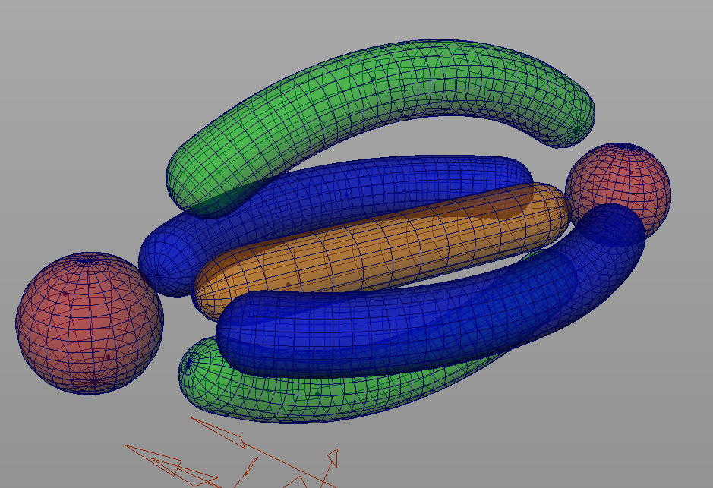






Slide 256
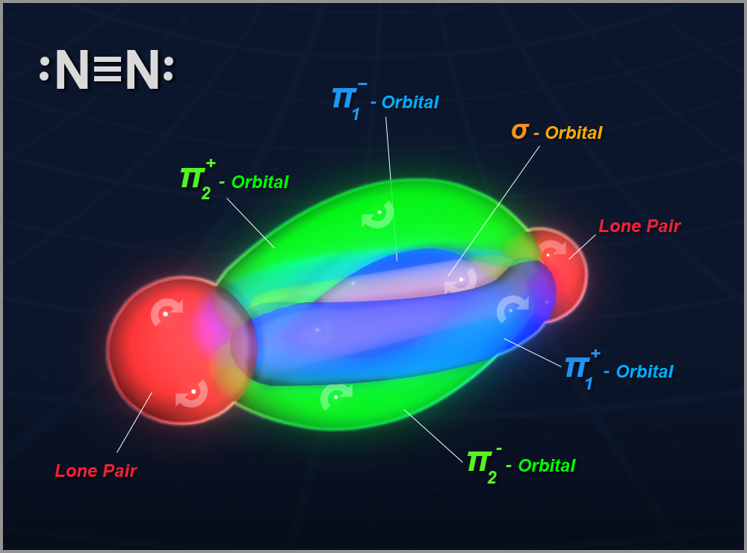




Slide 257
The N₂ Molecule
N N
So a triple bond is

Slide 258
The N₂ Molecule
N N
σ
So a triple bond is
a σ-bond

Slide 259
The N₂ Molecule
π₁
N N
σ
So a triple bond is
a σ-bond
and 2 π-bonds

Slide 260
The N₂ Molecule
π₁
N N
σ
π₂
So a triple bond is
a σ-bond
and 2 π-bonds

Slide 261


The N₂ Molecule
π₁
N N
σ
π₂
So a triple bond is
a σ-bond
and 2 π-bonds
In N₂ there are two lone pairs, too

Slide 262
Triple Bonding Elements

Slide 263
Triple Bonding Elements
Only three elements participate in triple bonds

Slide 264
Triple Bonding Elements
Only three elements participate in triple bonds
⁶ C

Slide 265
Triple Bonding Elements
Only three elements participate in triple bonds
⁶ C
⁷ N

Slide 266
Triple Bonding Elements
Only three elements participate in triple bonds
⁶ C
⁷ N
⁸ O

Slide 267
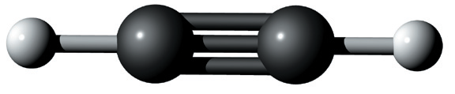
Your text’s (poor) depiction of a triple bond

Slide 268
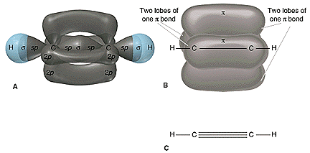
Better depictions of a triple bond
www.science.uwaterloo.ca/.../hybridcarbon.html

Slide 269
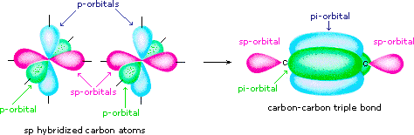
http://www.cem.msu.edu/~reusch/VirtualText/Images/sporbs.gif

Slide 270
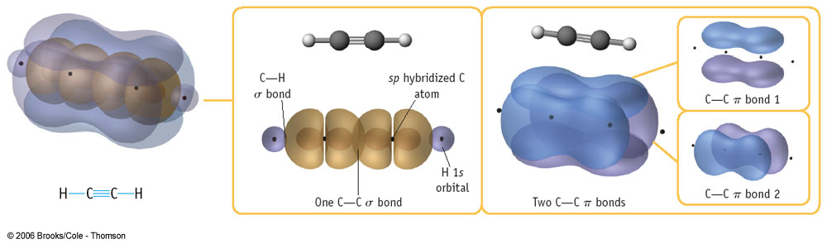
http://itl.chem.ufl.edu/2045/react/1012.jpg

Slide 271
Simple Lewis Structures
Element Bonds Lone pairs
H 1
C 4
N 3-4 1- 0
P 3-4 1- 0
O 2 2
S 2 2
Halogens 1 3

Slide 272
Lewis Structures for polyatomic molecules

Slide 273
Example 1: Water
First, you need the molecule’s skeletal structure
I’ll provide this or give you enough information to deduce it
For example, in water, oxygen is the central atom

Slide 274
Example 1: Water
H
O
H

Slide 275
Example 1: Water
H
O
H
Central atom

Slide 276
Example 1: Water
H
O
H
Terminal atoms

Slide 277
Example 1: Water
H
O
H
Now start checking each atom for its typical bonding pattern

Slide 278
Example 1: Water
H
O
H
Each hydrogen forms one covalent bond

Slide 279
Example 1: Water
H
O
H
Each hydrogen forms one covalent bond

Slide 280
Example 1: Water
H
O
H
Each hydrogen forms one covalent bond

Slide 281
Example 1: Water
H
O
H
Oxygen forms two covalent bonds and has 2 lone pairs

Slide 282
Example 1: Water
H
O
H

Slide 283
Example 1: Water
H
O
H
In this molecule there are

Slide 284
Example 1: Water
σ
σ
H
O
H
In this molecule there are
2 σ-bonds

Slide 285
Example 1: Water
σ
σ
H
O
H
In this molecule there are
2 σ-bonds
2 lone pairs

Slide 286
Example 2: Carbon Dioxide
In carbon dioxide, CO₂, carbon is the central atom

Slide 287
Example 2: Carbon Dioxide
O
C
O

Slide 288
Example 2: Carbon Dioxide
O
C
O
Each oxygen forms 2 bonds and has 2 lone pairs

Slide 289
Example 2: Carbon Dioxide
O
C
O
Each oxygen forms 2 bonds and has 2 lone pairs

Slide 290
Example 2: Carbon Dioxide
O
C
O
Each oxygen forms 2 bonds and has 2 lone pairs

Slide 291
Example 2: Carbon Dioxide
O
C
O
Carbon forms 4 bonds

Slide 292
Example 2: Carbon Dioxide
O
C
O

Slide 293
Example 2: Carbon Dioxide
O
C
O
In this molecule there are

Slide 294
Example 2: Carbon Dioxide
σ
σ
O
C
O
In this molecule there are
2 σ-bonds

Slide 295
Example 2: Carbon Dioxide
σ
σ
O
C
O
π
π
In this molecule there are
2 σ-bonds
2 π-bonds

Slide 296
Example 2: Carbon Dioxide
σ
σ
O
C
O
π
π
In this molecule there are
2 σ-bonds
2 π-bonds
4 lone pairs

Slide 297
Example 3: Ethyl Alcohol
H
H
H
C
C
O
H
H
H

Slide 298
Example 3: Ethyl Alcohol
H
H
H
C
C
O
H
H
H
1 bond per hydrogen

Slide 299
Example 3: Ethyl Alcohol
H
H
H
C
C
O
H
H
H
1 bond per hydrogen

Slide 300
Example 3: Ethyl Alcohol
H
H
H
C
C
O
H
H
H
4 bonds per carbon

Slide 301
Example 3: Ethyl Alcohol
H
H
H
C
C
O
H
H
H
2 bonds and 2 lone pairs for oxygen

Slide 302
Example 3: Ethyl Alcohol
H
H
H
C
C
O
H
H
H

Slide 303
Example 3: Ethyl Alcohol
H
H
H
C
C
O
H
H
H
The condensed structural formula for ethyl alcohol is CH₃CH₂OH

Slide 304
Example 3: Ethyl Alcohol
H
H
H
C
C
O
H
H
H
In this molecule there are

Slide 305
Example 3: Ethyl Alcohol
H
H
σ
σ
H
σ
C
σ
C
σ
O
σ
H
σ
σ
H
H
In this molecule there are
8 σ-bonds

Slide 306
Example 3: Ethyl Alcohol
H
H
σ
σ
H
σ
C
σ
C
σ
O
σ
H
σ
σ
H
H
In this molecule there are
8 σ-bonds
2 lone pairs

Slide 307
Example 3: Ethyl Alcohol
H
H
σ
σ
H
σ
C
σ
C
σ
O
σ
H
σ
σ
H
H
If you mix the three compounds we’ve just drawn (H₂O, CO₂, and ethyl alcohol)...

Slide 308
Example 3: Ethyl Alcohol
H
H
σ
σ
H
σ
C
σ
C
σ
O
σ
H
σ
σ
H
H
…you have the main ingredients in champagne,

Slide 309
Example 3: Ethyl Alcohol
H
H
σ
σ
H
σ
C
σ
C
σ
O
σ
H
σ
σ
H
H
which can make you tipsy!

Slide 310
Example 4: Hydrogen Cyanide
Hydrogen cyanide, HCN, is a toxic gas because it sits on the oxygen-binding site of hemoglobin
Carbon is the central atom

Slide 311
Example 4: Hydrogen Cyanide
H
C
N

Slide 312
Example 4: Hydrogen Cyanide
H
C
N
1 bond for the hydrogen

Slide 313
Example 4: Hydrogen Cyanide
H
C
N
4 bonds for the carbon

Slide 314
Example 4: Hydrogen Cyanide
H
C
N
3 bonds and 1 lone pair for nitrogen

Slide 315
Example 4: Hydrogen Cyanide
H
C
N

Slide 316
Example 4: Hydrogen Cyanide
H
C
N
In this molecule there are

Slide 317
Example 4: Hydrogen Cyanide
H
σ
C
N
σ
In this molecule there are
2 σ-bonds

Slide 318
Example 4: Hydrogen Cyanide
H
σ
C
π
N
σ
π
In this molecule there are
2 σ-bonds
2 π-bonds

Slide 319
Example 4: Hydrogen Cyanide
H
σ
C
π
N
σ
π
In this molecule there are
2 σ-bonds
2 π-bonds
1 lone pair

Slide 320
Naming Binary Molecular Compounds
Different schemes for ionic compounds vs. covalent compounds
You can’t name ‘em if you can’t classify ‘em
Ionics start with a metal or ammonium
Covalents start with a nonmetal or metalloid

Slide 321
Covalent Compound Names
Least electronegative element generally first (Table 3.5, page 74)
Most electronegative element generally second -- with “-ide” ending
Need to use numerical prefixes because no charges to help determine ratios

Slide 322
Numerical Prefixes
1 mono-
2 di-
3 tri-
4 tetra-
5 penta-
6 hexa-
7 hepta-
8 octa-
9 nona-
10 deca-

Slide 323
Covalent Compound Names

Slide 324
Covalent Compound Names
(prefix) element

Slide 325
Covalent Compound Names
(prefix) element
(space)

Slide 326
Covalent Compound Names
(prefix) element
(space)
(prefix) element with “-ide” ending

Slide 327
Covalent Compound Names
(prefix) element
(space)
(prefix) element with “-ide” ending
What is the name of BF₃?

Slide 328
Covalent Compound Names
(prefix) element
(space)
(prefix) element with “-ide” ending
boron
What is the name of BF₃?

Slide 329
Covalent Compound Names
(prefix) element
(space)
(prefix) element with “-ide” ending
Mono prefix rarely used
boron
What is the name of BF₃?

Slide 330
Covalent Compound Names
(prefix) element
(space)
(prefix) element with “-ide” ending
boron
What is the name of BF₃?

Slide 331
Covalent Compound Names
(prefix) element
(space)
(prefix) element with “-ide” ending
boron tri-
What is the name of BF₃?

Slide 332
Covalent Compound Names
(prefix) element
(space)
(prefix) element with “-ide” ending
boron trifluoride
What is the name of BF₃?

Slide 333
Covalent Compound Names
(prefix) element
(space)
(prefix) element with “-ide” ending
boron trifluoride
What is the name of BF₃?

Slide 334
Covalent Compound Names
(prefix) element
(space)
(prefix) element with “-ide” ending
What is the name of N₂O₅?

Slide 335
Covalent Compound Names
(prefix) element
(space)
(prefix) element with “-ide” ending
di-
What is the name of N₂O₅?

Slide 336
Covalent Compound Names
(prefix) element
(space)
(prefix) element with “-ide” ending
dinitrogen
What is the name of N₂O₅?

Slide 337
Covalent Compound Names
(prefix) element
(space)
(prefix) element with “-ide” ending
dinitrogen
What is the name of N₂O₅?

Slide 338
Covalent Compound Names
(prefix) element
(space)
(prefix) element with “-ide” ending
dinitrogen penta-
What is the name of N₂O₅?

Slide 339
Covalent Compound Names
(prefix) element
(space)
(prefix) element with “-ide” ending
dinitrogen pentoxide
What is the name of N₂O₅?

Slide 340
Covalent Compound Names
(prefix) element
(space)
(prefix) element with “-ide” ending
dinitrogen pentoxide
What is the name of N₂O₅?

Slide 341
Covalent Compound Names
(prefix) element
(space)
(prefix) element with “-ide” ending
dinitrogen pentoxide
(Note: the “a” of the prefix is dropped with oxide)

Slide 342
Covalent Compound Names
(prefix) element
(space)
(prefix) element with “-ide” ending
What is the name of NI₃?

Slide 343
Covalent Compound Names
(prefix) element
(space)
(prefix) element with “-ide” ending
nitrogen
What is the name of NI₃?

Slide 344
Covalent Compound Names
(prefix) element
(space)
(prefix) element with “-ide” ending
nitrogen tri-
What is the name of NI₃?

Slide 345
Covalent Compound Names
(prefix) element
(space)
(prefix) element with “-ide” ending
nitrogen triiodide
What is the name of NI₃?

Slide 346
Unusual Names
Mono- is used to distinguish between two compounds of the same element pair
CO carbon monoxide
CO₂ carbon dioxide
Some common compounds have trivial names
H₂O water
NH₃ ammonia

Slide 347
What type of compound is SF₄?
ionic
covalent

Slide 348
What type of compound is SF₄?
ionic
covalent
Sulfur is a nonmetal, so name it as a covalent compound

Slide 349
What is the name of SF₄?
Sulfur fluoride
Sulfur fluorine
Monosulfur tetrafluoride
Sulfide tetrafluoride
Sulfur tetrafluoride
Sulfur tetrafluorine

Slide 350
What is the name of SF₄?
Sulfur fluoride
Sulfur fluorine
Monosulfur tetrafluoride
Sulfide tetrafluoride
Sulfur tetrafluoride
Sulfur tetrafluorine
Prefix needed to specify number of F atoms

Slide 351
What type of compound is Cu(HCO₃)₂?
ionic
covalent

Slide 352
What type of compound is Cu(HCO₃)₂?
ionic
covalent
Copper is a metal, so name it as an ionic compound

Slide 353
What is the name of Cu(HCO₃)₂?
Copper dibicarbonate
Copper(II) bicarbonate
Copper(I) bicarbonate
Copper(II) hydrogen carbonate
Copper(I) hydrogen carbonate
Cupric hydrogen carbonate

Slide 354
What is the name of Cu(HCO₃)₂?
Copper dibicarbonate
Copper(II) bicarbonate
Copper(I) bicarbonate
Copper(II) hydrogen carbonate
Copper(I) hydrogen carbonate
Cupric hydrogen carbonate
Here are three possibilities. We can tell it’s copper(II) because it required two bicarbonate -1 ions to balance the charges.

Slide 355
What type of compound is (NH₄)₂SO₄?
ionic
covalent

Slide 356
What type of compound is (NH₄)₂SO₄?
ionic
covalent
NH₄⁺, ammonium, is the only nonmetal polyatomic cation we’ve encountered so far. Any time you see it at the start of a formula, it‘s an ionic compound.

Slide 357
What is the name of (NH₄)₂SO₄?
Diammonium sulfur tetroxide
Ammonium sulfite
Diammoniun sulfate
Ammonium sulfate
Diammonium sulfite

Slide 358
What is the name of (NH₄)₂SO₄?
Diammonium sulfur tetroxide
Ammonium sulfite
Diammoniun sulfate
Ammonium sulfate
Diammonium sulfite
Ionic compounds don’t include number prefixes unless they’re part of the ion name itself.

Slide 359
What type of compound is Sn(ClO₃)₄?
ionic
covalent

Slide 360
What type of compound is Sn(ClO₃)₄?
Sn (tin) is a metal, so name it as an ionic
ionic
covalent

Slide 361
What is the name of Sn(ClO₃)₄?
tin chlorite
tin chlorate
stannic chlorite
stannic chlorate
tin(IV) chlorite
tin(IV) chlorate
tin(IV) tetrachlorite
tin(IV) tetrachlorate

Slide 362
What is the name of Sn(ClO₃)₄?
tin chlorite
tin chlorate
stannic chlorite
stannic chlorate
tin(IV) chlorite
tin(IV) chlorate
tin(IV) tetrachlorite
tin(IV) tetrachlorate
The subscript on ClO₃ tells us this is tin (IV)

Slide 363
What is the name of Sn(ClO₃)₄?
tin chlorite
tin chlorate
stannic chlorite
stannic chlorate
tin(IV) chlorite
tin(IV) chlorate
tin(IV) tetrachlorite
tin(IV) tetrachlorate

Slide 364
What type of compound is PCl₃?
ionic
covalent

Slide 365
What type of compound is PCl₃?
ionic
covalent
Phosphorus is a nonmetal, so name it as a covalent compound

Slide 366
What is the name of PCl₃?
Phosphorus trichloride
Phosphide trichlorine
Phosphotrichloride
Phosphorus chloride
Phosphorus trichlorine

Slide 367
What is the name of PCl₃?
Phosphorus trichloride
Phosphide trichlorine
Phosphotrichloride
Phosphorus chloride
Phosphorus trichlorine
We need the prefix on chlorIDE to tell us the repeat number.

Slide 368
Example 1: Laughing Gas
Let’s try a couple of examples
For starters, let’s consider laughing gas
It’s an anesthetic used by dentists
It’s nonsystematic name is nitrous oxide
It’s formula is N₂O

Slide 369
Example 1: Laughing Gas
1. Find total # of valence e-’s in molecule or ion
2 x N = 2 x 5e⁻ = 10 e⁻
1 x O = 1 x 6e⁻ = 6 e⁻
species charge = 0 e⁻
______________________________
Total 16 e⁻

Slide 370
Example 1: Laughing Gas
2. Connect the skeleton with single bonds
N
N
O
16 e⁻

Slide 371
Example 1: Laughing Gas
3. Place lone pairs to give non-H terminal atoms an octet
N
N
O
16 e⁻

Slide 372
Example 1: Laughing Gas
3a. Check to see how many e⁻’s are left and all octets
N
N
O
8 e⁻’s, octet okay
16 e⁻

Slide 373
Example 1: Laughing Gas
3a. Check to see how many e⁻’s are left and all octets
N
N
O
8 + 8 = 16 e⁻’s, octet okay
16 e⁻

Slide 374
Example 1: Laughing Gas
3a. Check to see how many e⁻’s are left and all octets
N
N
O
16 e⁻’s used, octet NOT okay
16 e⁻

Slide 375
Example 1: Laughing Gas
3a. Check to see how many e⁻’s are left and all octets
N
N
O
Uh-oh! We’re short e⁻’s!
16 e⁻

Slide 376
Example 1: Laughing Gas
If e⁻’s are short, go to 5
N
N
O
Uh-oh! We’re short e⁻’s!
16 e⁻

Slide 377
Example 1: Laughing Gas
5. If short e-’s, look for multiple bonders or e⁻ deficients
N
N
O
Uh-oh! We’re short e⁻’s!
16 e⁻

Slide 378
Example 1: Laughing Gas
5. If short e-’s, look for multiple bonders or e⁻ deficients
N
N
O
We’re short 4 e⁻’s, so need 2 multiple bonds
16 e⁻

Slide 379
Example 1: Laughing Gas
5. If short e-’s, look for multiple bonders or e⁻ deficients
N
N
O
Move a lone pair into a shared position
16 e⁻

Slide 380
Example 1: Laughing Gas
5. If short e-’s, look for multiple bonders or e⁻ deficients
N
N
O
Move a lone pair into a shared position
16 e⁻

Slide 381
Example 1: Laughing Gas
5. If short e-’s, look for multiple bonders or e⁻ deficients
N
N
O
Move another lone pair into a shared position
16 e⁻

Slide 382
Example 1: Laughing Gas
5. If short e-’s, look for multiple bonders or e⁻ deficients
N
N
O
Move another lone pair into a shared position
16 e⁻

Slide 383
Example 1: Laughing Gas
5. If short e-’s, look for multiple bonders or e⁻ deficients
N
N
O
Now last octet is full; 16 e⁻’s preserved!
16 e⁻

Slide 384
Example 1: Laughing Gas
N
N
O
We’re done!
16 e⁻

Slide 385
Example 1: Laughing Gas
N
N
O
NOTE: This would have been okay, too...
16 e⁻

Slide 386
Example 1: Laughing Gas
N
N
O
…but it’s not the way nature prefers.
16 e⁻

Slide 387
Example 1: Laughing Gas
N
N
O
It wouldn’t affect geometry anyway
16 e⁻

Slide 388
Laughing Gas
N
N
O
Where did these e⁻’s come from?

Slide 389
Laughing Gas
N
N
O
Left N
Middle N
Right O

Slide 390
Laughing Gas
It’s a coordinate covalent bond!
N
N
O
Left N
Middle N
Right O

Slide 391
Laughing Gas
Both e⁻’s came from the N
N
N
O
Left N
Middle N
Right O

